Slide 1
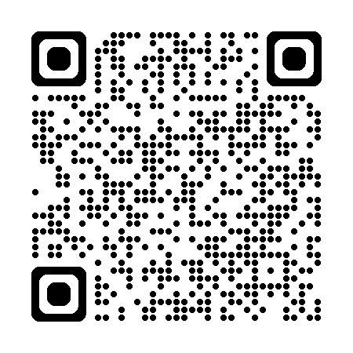
Microsoft | Azure SRE Agent
AI at Scale: Turning Insight into Enterprise Advantage
Agentic Operations with
Azure SRE Agent
<Your-Name>
<Your-Designation>
Microsoft
Notes:
[TITLE SLIDE - You]
Welcome everyone to this session. I’m <Your-Name>.
Today we're going to talk about something that directly connects to this year's AFC theme — "AI at Scale: Turning Insight into Enterprise Advantage" — by sharing the story of how we built an AI agent that runs cloud operations at enterprise scale inside Microsoft. Not a prototype. Not a demo. A production system that has mitigated over 35,000 incidents and saved over 50,000 engineering hours.
We'll share real data, real lessons, and real advice for anyone building AI agents for enterprise use cases.

Slide 2
SECTION 01
The Problem
Operations at scale is a human bottleneck. More services, more alerts, more tickets, more toil — and never enough engineers.
Notes:
[SECTION DIVIDER - THE PROBLEM]
Let's start with why we built this in the first place.

Slide 3
The Toil Problem at Microsoft Scale
200+
24/7
80%
Days
Azure services
On-call rotations
Repetitive investigations
Mean time to mitigate
Each with unique failure modes, runbooks, and on-call teams
Engineers paged at 3am for issues that follow the same pattern
Same diagnostic steps, same KQL queries, same mitigation actions
Even when the fix is known, human latency dominates TTM
The Insight
Traditional automation (runbooks, scripts, playbooks) breaks every time the failure mode is slightly different.
What if we could give AI agents the same tools and reasoning an experienced SRE uses — but at machine speed?
Notes:
[THE TOIL PROBLEM]
Microsoft runs over 200 Azure services. Each has its own failure modes, its own runbooks, its own on-call teams. Engineers get paged at 3am to investigate issues that follow the same diagnostic pattern they've seen a hundred times before.
Here's the dirty secret: about 80% of incident investigations are repetitive. Same KQL queries, same diagnostic steps, same mitigation actions. Yet the mean time to mitigate is still measured in hours because of human latency — finding the right person, them getting context, running diagnostics, executing the fix.
Traditional automation — scripts, playbooks, Logic Apps — works great for exact-match failures. But the moment the failure mode is slightly different, they break. What we needed was something that could reason about novel situations the way an experienced SRE does, but at machine speed.

Slide 4
SECTION 02
The Solution
Azure SRE Agent — End to end agentic operations platform, reducing toil for any platform at scale
Notes:
[SECTION DIVIDER - THE SOLUTION]
So we built Azure SRE Agent.

Slide 5
Azure SRE Agent — End-to-End Agentic Operations
Any Toil
Any Platform
At Scale
Incident response, scheduled workflows, customer support, developer operations
Azure native, hybrid via Azure Arc, multi-cloud via connectors
Some of the largest engineering teams at Microsoft using SRE Agent and several Fortune 500 companies
Extensible
Enterprise Ready
MCP, Python Code Interpreter, Custom Agents + Skills, Browser Operator, Knowledge, Triggers
RBAC, Managed Identity, OBO, Hooks, Audit, Evaluation, Learning, Human-in-loop, Tenant Isolation
Generally Available — March 2026 | Built on Azure, for Azure, extensible to any platform
Notes:
[WHAT IS SRE AGENT]
Azure SRE Agent is an AI-powered operations platform. It's generally available today on Azure.
The numbers you see — 1,300+ agents deployed at Microsoft, 35,000+ incidents mitigated, 50,000+ engineering hours saved — these are production numbers as of this month.
It handles any kind of operational toil: incident response, scheduled monitoring, customer support workflows, developer operations. It works across Azure natively and extends to hybrid and multi-cloud via the Model Context Protocol. And it scales — our largest customer team runs 51 agents with up to 87 custom tools per agent.

Slide 6
Three Ways to Use Azure SRE Agent
Interactive
Reactive
Proactive
Ask & Collaborate
Alert-Driven Response
Scheduled & Autonomous
✓ Chat directly in the Portal
✓ Responds to Azure Monitor alerts
✓ Scheduled tasks on cron expressions
✓ Ask questions, run diagnostics
✓ Integrates PagerDuty, ServiceNow, Release & HTTP Triggers
✓ Continuous health & compliance checks
✓ Natural language operations
✓ Automated triage and initial RCA
✓ Anomaly detection across resources
✓ Upload images, files, HAR traces
✓ Triggers mitigation with approval
✓ Resource optimization & cost analysis
Notes:
[THREE MODES]
SRE Agent operates in three complementary modes.
Interactive: You chat with it in the Azure Portal. Ask questions, run diagnostics, upload HAR traces. Think of it as having a senior SRE always available.
Reactive: It responds to Azure Monitor alerts, PagerDuty, ServiceNow. When an alert fires, the agent automatically triages, performs RCA, and can trigger mitigation — with human approval gates.
Proactive: Scheduled tasks on cron expressions. Continuous health checks, compliance scanning, anomaly detection. The agent finds problems before they become incidents.
The magic is when all three work together — proactive monitoring catches an anomaly, reactive mode handles the resulting alert, and interactive mode lets the engineer ask follow-up questions.

Slide 7


Azure SRE Agent
User
SRE Agent
Cloud resources
💻
Portal / CLI
💬
Reasoning Engine
📊
Metrics and logs
🔔
Alerts and incidents
🔧
Code Sandbox + Interpreter
⚙️
Compute and Apps
⏰
Scheduled Tasks
🔌
Connectors, Skills and tools
🗄️
Data and infra
🌐
HTTP triggers
📚
Knowledge and memory
🌍
3rd party and custom
Governance and human-in-the-loop
🛡️
✅
🪝
🔒
Azure RBAC
Human approval
Safety hooks
Isolated compute
Notes:
An AI operations agent that monitors your resources, responds to incidents, and automates daily SRE tasks — across Azure and beyond.
Needs and interactions are surfaced to the user from SRE agent based on your established configurations and tasks.
Azure Portal / CLI - Chat with your agent, ask questions, trigger actions, review findings
Alerts and incidents - Azure Monitor, ICM, PagerDuty — auto-investigate when things break
Scheduled tasks - Recurring health checks, capacity reviews, compliance scans
Through secure HTTPS connection, the SRE agent collaborates with the user by leveraging:
Reasoning Engine - LLM-powered. Plans investigation steps and executes autonomously
Skills and tools - K8s diagnostics, metric analysis, log search, CPU/memory profiling
Connectors - Kusto, Geneva, MCP servers, Teams, GitHub, Datadog, custom APIs
Knowledge and Memory - Upload runbooks & docs. Learns from past incidents over time
And we achieve specialization in output and responses by grounding SRE agent in resources in Azure and beyond:
Metrics and Logs - Azure Monitor, Log Analytics, App Insights, Kusto, Datadog
Compute and Apps - AKS, Container Apps, App Service, VMs, Functions, on-prem K8s
Data and Infra - Databases, Storage, Networking, Key Vault, any ARM resource
3rd-party and custom info - GitHub, PagerDuty, custom APIs via MCP connector protocol
Finally, stay in control with human-in-the-loop and agent governance for every interaction.
Azure RBAC – Agents act with your permissions only
Human approval – Write operations require explicit approval action
Safety hooks – custom governance checks occur before actions
Isolated Compute – each agent runs in its own container app
Note: All features available in East US 2 · Sweden Central · Australia East — with more regions coming

Slide 8
AZURE SRE AGENT
Pay-as-you-go · Per agent
Cost at a Glance
Simple, predictable pricing built on Azure Agent Units (AAUs)
FIXED ALWAYS-ON COST
ACTIVE-FLOW ALLOCATION
~$10 / day per agent
10,000 AAU ≈ $1,000 / month
Covers provisioning cost — billed as long as the agent exists.
Variable cost when the agent works (chat, investigations, remediations). 10K AAU × $0.10 = $1,000.
KEY RULES
THE SIMPLE MATH
✓
You set the cap. Active-flow allocation is fully configurable — minimum 500, maximum 1,000,000 AAUs/month. Default 10,000 AAUs.
Floor: ~$10/day × 30 days ≈ $300/month baseline per agent.
✓
Adjust anytime. Increases take effect immediately; decreases below current usage apply next month.
Cap: Default-style budget of 10,000 AAU/month ≈ $1,000 for active work.
✓
No active AAU if not triggered. Active-flow AAUs accrue only while the agent is doing work.
!
Always-on still applies. The ~$10/day baseline runs until the agent is deleted (even if stopped).
Stop when capped: Agent keeps monitoring but pauses chat & actions until next month.
Source: Azure SRE Agent pricing & billing documentation (aka.ms/sreagent/pricing)
Illustrative AAU price of $0.10 used; actual rates vary by model and region.

Slide 9
SECTION 03
Customer Zero Proof
Real production data from Microsoft's own engineering teams. Not demos. Not POCs. Real incidents, real mitigation, real savings.
Notes:
[SECTION DIVIDER - CUSTOMER ZERO]
Now the part I'm most excited about: real production data from Microsoft's own engineering teams.

Slide 10
Business impact of Azure SRE Agent
1800+ Agents deployed
Agentic operations with human-in-loop when needed
Incident Management
Release Management
Security Management
300K incidents managed
8K release threads
11K best practice scans
245K incident enriched
80K total actions
200 security scans
5 min median TTM
50 pipelines
250K daily reports
Impact at Microsoft:
55,000+ incidents handled autonomously
80,000+ developer hours saved
*Release and security management 30d data, incident management since May 2025
Notes:
Free flow talk.. And then
Let me talk to you about another use case where the Agentic era is truly helping us reduce toil
Since implementing SRE agent, the impact at Microsoft has been widespread across teams with over 35,000 incidents handled autonomously and ultimately saving developers 50,000 hours of operations work.
For incident management:
227k incidents have been managed with help from Azure SRE Agent
Azure SRE Agent has enriched context for the human-in-the-loop for over 220k incidents
This has resulted in a 5-minute median time-to-mitigation
For releases:
We’ve created over 1.8k release threads using 51k total actions
This is a 70x monthly growth of what we were able to do before
For security:
We’ve implemented 17k security best practice scans throughout environments to kick of 215k actions
This runs the scanning for over 600 agents

Slide 11
Azure Container Apps — Last 30 Days
17 total agents
328
1,083
91.4%
89.8%
Mitigated
Enriched
Agent Coverage
Positive RCA Feedback
TTM Impact — Livesite Incidents (LSI)
TTM Impact — Customer-Reported (CRI)
SRE Agent Mitigated
10 min
199 incidents
SRE Agent Mitigated
58 min
129 CRIs
Agent Enriched + Human
6.9 hours
270 incidents
Human Only
26.8 hours
55 CRIs
Human Only
10.7 hours
3 incidents
64x faster
27.7x faster
Agent mitigates LSI in 10 min vs 10.7 hours human-only
CRI from 26.8h down to 58 min with agent
Near-complete coverage: only 3 LSI incidents had no agent involvement. Trusted RCA — 89.8% of engineers found agent's root cause analysis useful.
Notes:
[CONTAINER APPS - You]
First: Azure Container Apps. This team runs 3 incident agents and 17 total agents.
Look at the TTM numbers on the left. When SRE Agent mitigates a livesite incident, the median time is 10 minutes. When a human handles it alone — 10.7 hours. That's 64x faster.
For customer-reported incidents — CRIs — the agent resolves them in 58 minutes. Without the agent, 26.8 hours. Almost 28x faster.
But here's what really stands out: 91.4% agent coverage. Out of 1,190 incidents last month, only 3 livesite incidents had zero agent involvement. Wall-to-wall coverage.
And the engineers trust it: 89.8% positive RCA feedback. Nearly 90% of the time, the engineer said the agent's root cause analysis was useful. This isn't a notification forwarder — it's a trusted first responder.

Slide 12
App Service Engineering — Last 30 Days
21 custom agents
1,571
2,334
3 min
809x
Mitigated
Enriched
LSI Median TTM
Faster Than Human
TTM Impact — Livesite Incidents (LSI)
TTM Impact — Customer-Reported (CRI)
SRE Agent Mitigated
3 min
741 incidents
SRE Agent Mitigated
4.2 hours
819 CRIs
Agent Enriched + Human
16.1 hours
350 incidents
Human Only
24.6 hours
345 CRIs
Human Only
40.5 hours
1,603 incidents
809x faster
2.5x faster human resolution
Agent mitigates LSI in 3 min vs 40.5 hours human-only
LSI with enrichment: 16.1h vs 40.5h — diagnostics cut investigation in half
Deep customization driving results — teams run up to 87 custom tools purpose-built for their failure modes. 819 CRIs resolved autonomously.
Notes:
[APP SERVICE - You]
Now App Service Engineering — a much larger team with deeper customization.
21 custom agents, 51 total, with some running up to 87 custom tools purpose-built for their failure modes.
The headline: 809x faster. Agent mitigates livesite incidents in 3 minutes. Human-only resolution: 40.5 hours. Three minutes versus forty hours.
And there's a fascinating secondary signal: even when the agent doesn't fully mitigate, just having it enrich the incident cuts human resolution time in half. 16.1 hours with enrichment versus 40.5 without. The diagnostics the agent provides give the human engineer a massive head start.
This team proves that deep customization drives results. They didn't use a generic agent — they built domain-specific tools for their exact failure modes.

Slide 13
SRE Agent Managing Itself — SRE4SRE — Last 90 Days
1,542
96
906
157
4,736
Manual Chats
Incidents Processed
Code Edits / PRs
GitHub Issues
Scheduled Task Runs
Incidents
Code & PRs
58 resolved autonomously
Detect bug in prod → write fix + tests → open PR
Alert → RCA → mitigation, zero human touch
906 edits, 173 files, 2,167 validations
288 RCA discussion posts with evidence
12K GrepSearches, 17K ReadFiles across 4 repos
Scheduled Tasks
GitHub Issues
17 tasks → 4,736 fires → 79 daily reports
Public issues triaged automatically
1,318 daily-reporter sub-agent runs
Browse, extract, query logs, trace code
No alert goes uninvestigated
1,136 debugger runs, 946 browser actions
Notes:
[SRE4SRE - You]
And now my favorite: SRE Agent managing itself.
We've been dogfooding since October 2025. In the last 90 days: 1,542 manual chats, 96 incidents processed, 906 code edits, 157 GitHub issues triaged, 4,736 scheduled task runs.
The agent handles incidents end-to-end: alert fires, agent investigates, posts RCA with evidence, executes mitigation — zero human touch. 58 incidents fully resolved autonomously.
It writes code: detects a bug in production telemetry, writes the fix with tests, opens a PR, validates. 906 code edits across 173 files.
It triages our public GitHub issues: reads the issue, browses related logs, traces through our code, and posts findings.
It runs 17 scheduled tasks that fire 4,736 times, generating 79 daily health reports.
This is the ultimate forcing function. We can't ship a product we don't trust enough to run our own service.

Slide 14
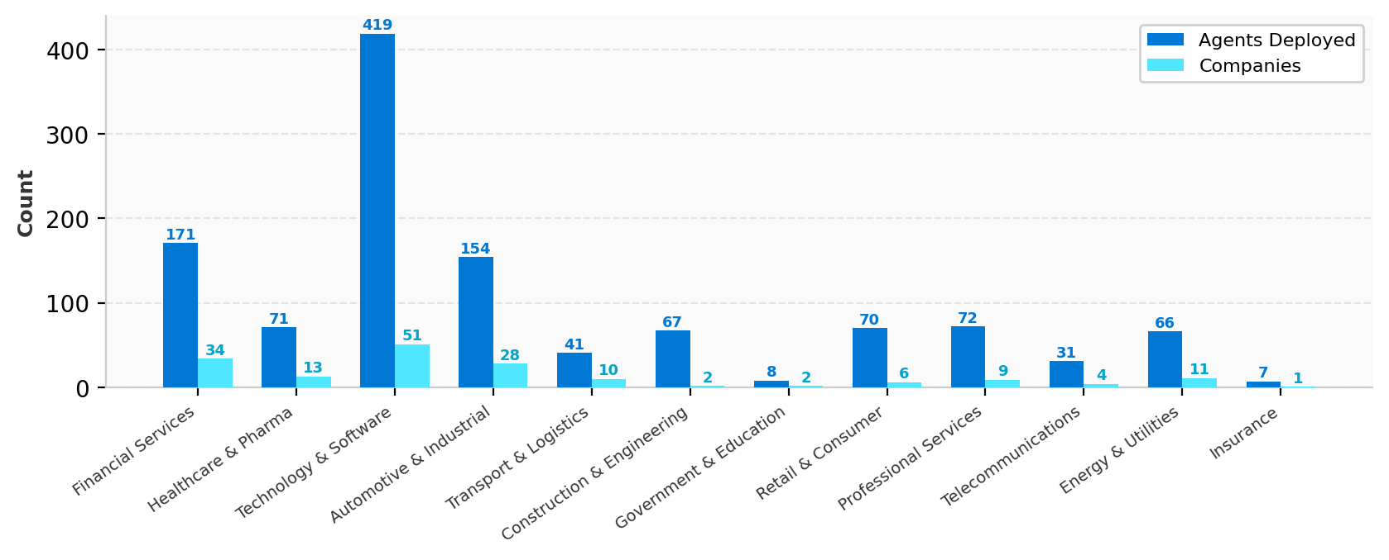
SRE Agent | 3P Customer Landscape by Industry Vertical
90-Day Window (Jan-Apr 2026)
1000+
1400+
1177
Total 3P Customers
Total Agents Deployed
Active Agents (90d)
Vertical | # | Total Agents | Active Agents
Financial Services | 36 | 175 | 36
Healthcare & Pharma | 13 | 71 | 12
Automotive & Industrial | 30 | 160 | 28
Technology & Software | 51 | 417 | 46
Transport & Logistics | 10 | 41 | 10
Construction & Engineering | 2 | 67 | 2
Retail & Consumer | 7 | 72 | 5
Government & Education | 2 | 8 | 2
Professional Services | 9 | 73 | 9
Telecommunications | 5 | 33 | 5
Energy & Utilities | 11 | 66 | 11
Insurance | 1 | 7 | 1

Slide 15
SECTION 04
Live Demo
See SRE Agent in action — portal walkthrough across Interactive, Reactive, and Proactive modes.
Demo Flow
Tab 1: Agent creation & configuration in Azure Portal
Tab 2: Interactive chat — diagnose a real issue with natural language
Tab 3: Alert-driven incident response — automated triage & RCA
Tab 4: Scheduled tasks — proactive monitoring & health checks
Tab 5: Connectors & custom tools — extensibility for any platform
Notes:
[DEMO DIVIDER]
And now I'll hand it over to Tina for a walkthrough of SRE Agent in action. Tina?

Slide 16
Key Takeaways
AI agents can fundamentally transform operations speed
Not incremental — 64x to 809x faster incident mitigation at Microsoft scale. This is a paradigm shift, not an optimization.
The value comes from deep integration, not generic chat
Connecting the agent to your specific tools, logs, metrics, and runbooks is what separates 'cool demo' from 'production essential.'
Safety and governance must be first-class, not afterthoughts
Enterprise adoption of autonomous AI requires explicit trust boundaries: RBAC, approval gates, safety hooks, full auditability.
Dogfooding reveals truth faster than any roadmap
Making SRE Agent manage itself surfaced problems we'd never find otherwise — and built genuine confidence in the product.
The future of operations is agentic — and it's here now
1,800+ agents deployed at Microsoft, 35K+ incidents mitigated, generally available today on Azure.
Notes:
[KEY TAKEAWAYS - You]
Five things to remember from this talk:
1. AI agents transform operations speed — not incrementally, but by orders of magnitude. 64x to 809x faster.
2. The value comes from deep integration with your specific tools, logs, and runbooks. Generic chat is table stakes.
3. Safety and governance must be first-class. RBAC, approval gates, safety hooks, auditability.
4. Dogfooding reveals truth. Make the agent manage itself.
5. The future of operations is agentic, and it's here now. 1,300+ agents at Microsoft, generally available on Azure.
Thank you for your time. Let's take questions.

Slide 17
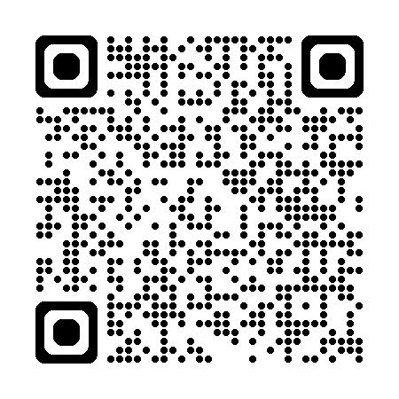
SECTION 06
Your one stop shop for Azure SRE Agent
Discover resources, report issues and
interact with the community
Questions?
https://aka.ms/sreagent/links
We'd love to hear your questions about building AI agents, operational automation, or anything you saw today.
<Your-Name>
<Your-Designation>,
Azure SRE Agent
linkedin.com/in/<your-id>
Notes:
[Q&A - Both]
Open it up for questions. Be ready for:
- "How does this compare to {competitor}?"
- "What LLM are you using?"
- "How do you handle prompt injection / security?"
- "What's the pricing model?"
- "Can it work with non-Azure resources?"
- "How do you handle PII in logs?"
- "What happens when the agent gets it wrong?"

Slide 18
Microsoft | Azure SRE Agent
Thank You
End to end agentic operations platform, reducing toil for any platform at scale
Try Azure SRE Agent
https://aka.ms/sreagent
Generally Available on Azure
Notes:
[THANK YOU - Both]
Thank you for attending. If you want to try Azure SRE Agent, it's generally available at aka.ms/sre-agent. Come talk to us afterward — we'd love to hear about your operational challenges and how AI agents might help.
Connect with us on LinkedIn!

Slide 19
Time to Mitigate — Before vs After SRE Agent
Container Apps LSI
64x faster
10 min vs 10.7 hours
Container Apps CRI
27.7x faster
58 min vs 26.8 hours
App Service LSI
809x faster
3 min vs 40.5 hours
App Service CRI
5.8x faster
4.2h vs 24.6 hours
Key takeaway: AI agents don't just assist — they fundamentally change the speed of operations. The biggest gains come from teams that deeply customize agent tools to their specific failure modes.
Notes:
[TTM CHART - You]
Here's the visual summary across both teams.
The bar chart tells the whole story. The red bars are human-only resolution times. The green bars are agent-mitigated times. In every case, the difference is not incremental — it's transformational.
The key takeaway here: AI agents don't just assist — they fundamentally change the speed of operations. And the biggest gains come from teams that deeply customize the agent's tools to their specific failure modes. App Service's 809x improvement didn't happen by accident — it came from 87 purpose-built tools.

Slide 20
How Customer Adoption Evolves Over Time
Onboarding
Low baseline while exploring
Weeks 0–3
Learning
Stabilizes as users learn what works
Weeks 4–11
Mature
Best scores, 10x usage intensity
Weeks 12+
The J-Curve: Customers who are not AI native take time to wrap their head around this
Usage intensity grows 8–10x. Mature customers at week 12+ average 99 threads/customer/week vs 9 at onboarding/learning.
Notes:
[MATURITY JOURNEY - You]
One more data point that I think is important for anyone building AI products: how adoption evolves over time.
We tracked 2,700+ customer subscriptions over 6 months. Two key curves: the blue line is quality (intent resolution score), and the teal line is usage intensity.
There's a clear J-curve. In weeks 0-2, customers explore. Weeks 5-7, scores actually dip — we call this the 'trough of disillusionment.' Customers move past simple hello-world queries into complex operational scenarios where the agent struggles more. But then they learn to frame requests better, customize their tools, and by week 12+ they're power users — 8-10x more usage than onboarding.
The implication: if you're building an AI product, expect this dip. Design your onboarding to help customers through it. The ones who survive become your biggest advocates.

Slide 21
APPENDIX
Agents Across the Software Lifecycle
Plan
Empowered PMs + spec-driven dev
Code
GitHub Copilot Coding Agent
Verify
GH Code Review + Advanced Security
Test
Automated evaluation agent*
Deploy
SRE Agent + Deployment agent*
Operate
SRE Agent for incident response
Document
Documentation agent*
Optimize
SRE Agent continuous opt.
→
→
→
→
→
→
→
1. Using Copilot CLI, VS Code via GH Copilot to build products, features and fix bugs
2. Coding agent automatically creates PRs to fix issues that are reported
3. Code review agent reviews code and provides recommendations
4. Microsoft Engineering teams use SRE Agent — 35K incidents mitigated, 150K enriched
5. SRE Agent for SRE Agent (SRE4SRE) — debug customer issues, provide answers, fix bugs
6. SRE4SRE runs scheduled tasks to find errors in telemetry and auto-fix code
7. Deployment agents manage deployments and releases
8. Security Management — manages security KPIs and follow-ups
9. Agents create documentation
* = emerging / internal prototype
Notes:
[APPENDIX - Reference only]
This slide provides the full lifecycle view for reference during Q&A if someone asks about the broader agentic DevOps vision.

Slide 22
Agentic DevOps — AI Across the Software Lifecycle
Plan
Code
Verify
Deploy
Operate
Optimize
→
→
→
→
→
Spec-driven development
GitHub Copilot Coding Agent
Code Review + Advanced Security
SRE Agent Release Management
SRE Agent Incident Response
SRE Agent Scheduled Tasks
How Microsoft is Using This Today
Coding agent creates PRs to fix reported issues automatically
SRE Agent mitigated 50K+ incidents across Microsoft engineering
SRE4SRE: SRE Agent debugging its own customer issues and fixing its own bugs
Scheduled tasks scan telemetry errors and auto-fix code
Notes:
[AGENTIC DEVOPS - You]
Before we dive into Customer Zero data, I want to zoom out. SRE Agent is part of a broader pattern we're seeing at Microsoft: agents across the entire software lifecycle.
We use GitHub Copilot for coding, Copilot for code review, SRE Agent for operations and deployment. And here's the recursive part — number 5 on this list — SRE Agent managing SRE Agent. We call it SRE4SRE. The agent debugs its own customer issues, finds bugs in its own telemetry, writes fixes, and opens PRs. We'll share that data shortly.

